Slide 1
Mental Health
Module 8

Slide 2

What is Mental Health?
Mental health is an important part of your overall health and well-being.
It includes:
Understanding your feelings
    Knowing how you think and feel about your life
    Understanding how you handle stress
    Taking care of yourself
    Exploring when and how you make healthy choices

Slide 3
Positive Mental Health
How can I encourage positive mental health?
Connecting with others
Being physically active
Getting enough sleep
Asking for help – It is OK!
Having a positive outlook
Eating healthy meals
Meditation
Prayer
Watching a funny movie
Being around loved ones
Writing

Slide 4
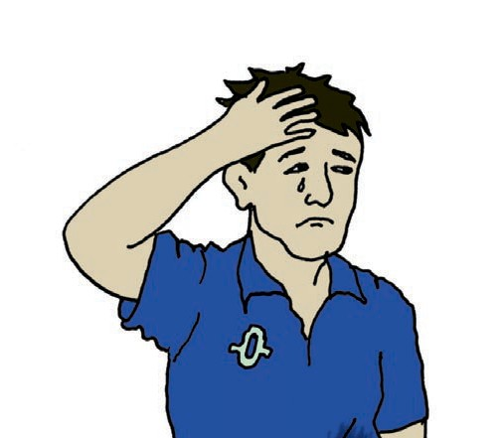











Concerns about Mental Health
You might be concerned about your mental health if you are feeling what emotions for more than 2 weeks?
Sad
Confused
Worried
Scared
Upset
Angry
Or if you:
Can’t sleep
Don’t feel like eating
Are feeling pain
Stop showering
Stop seeing friends
You may want to contact your doctor or someone else for help if:
These feelings continue,
Keep coming back, or
Keep you from living the life you want to live.

Slide 5
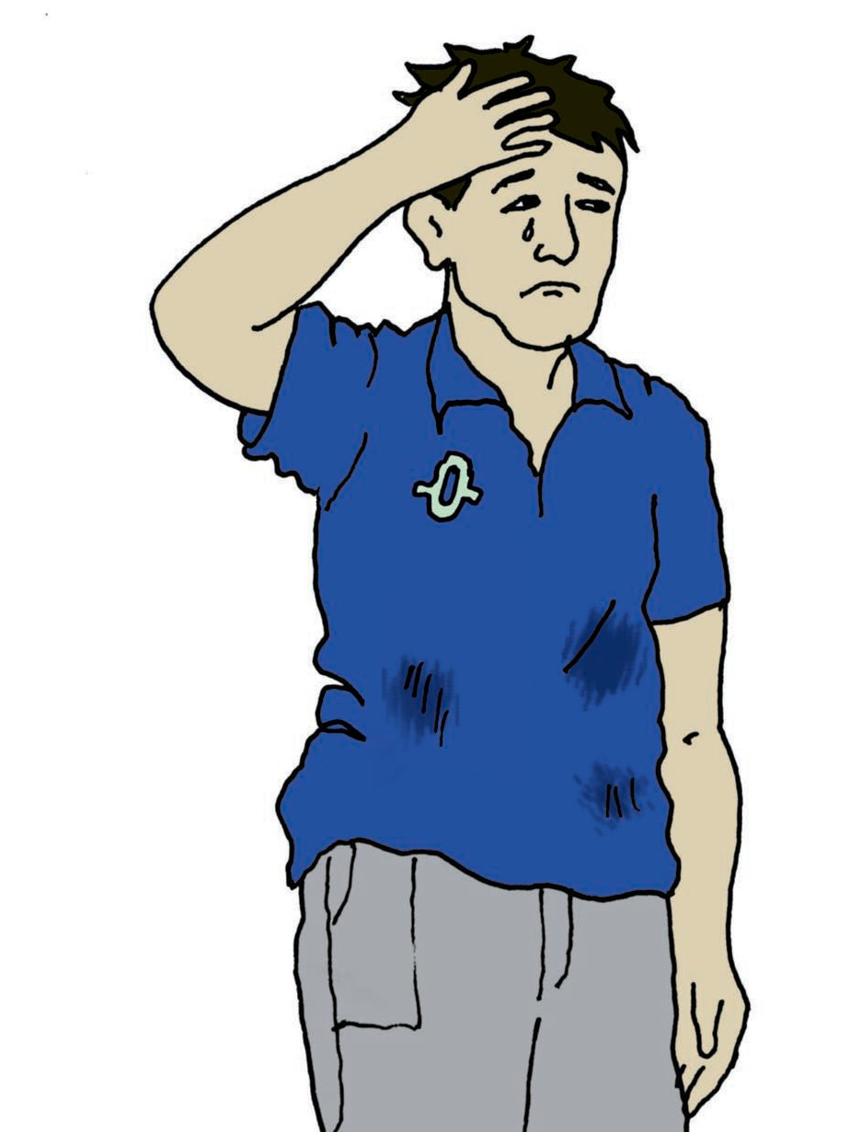

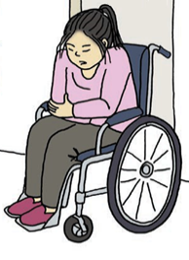
Is It OK to Ask For and Get Help?
YES!

Slide 6
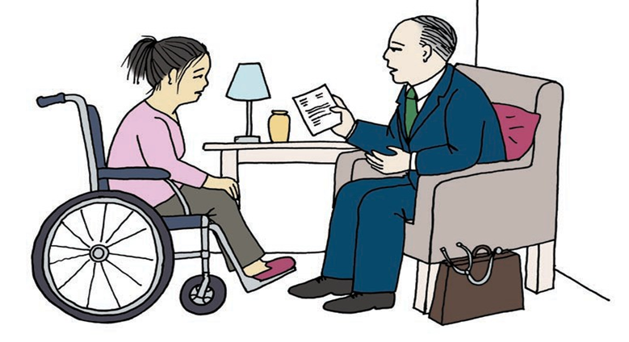
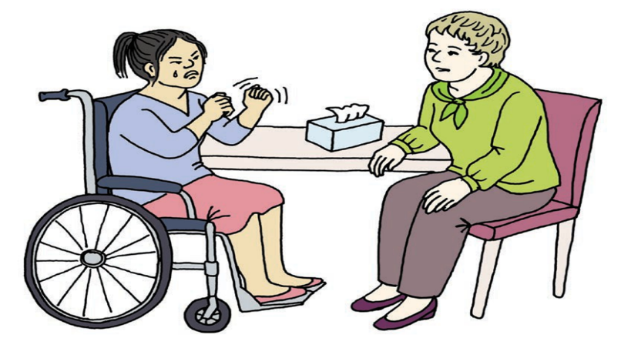
What If I Need Help with My Mental Health?
Who should you talk to?
People who know a lot about mental health and can offer treatment.
Psychologist,
Therapist,
Counselor,
Social worker, and
other mental health care providers.

Slide 7
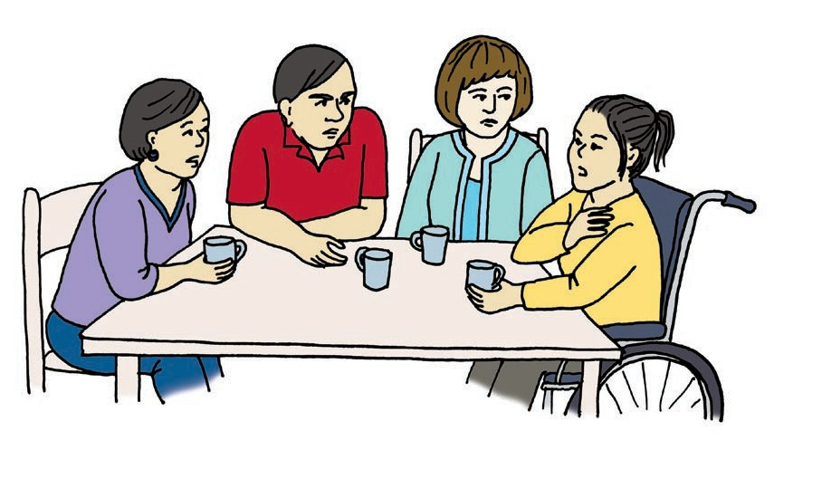
Other People Who Will Support Me
Besides a therapist or doctor, you can also find a person in your life who you trust and talk to them.
This person could be a:
Family member
Friend
Advocate
Staff person
Case worker
Another doctor
Telephone crisis line worker

Slide 8
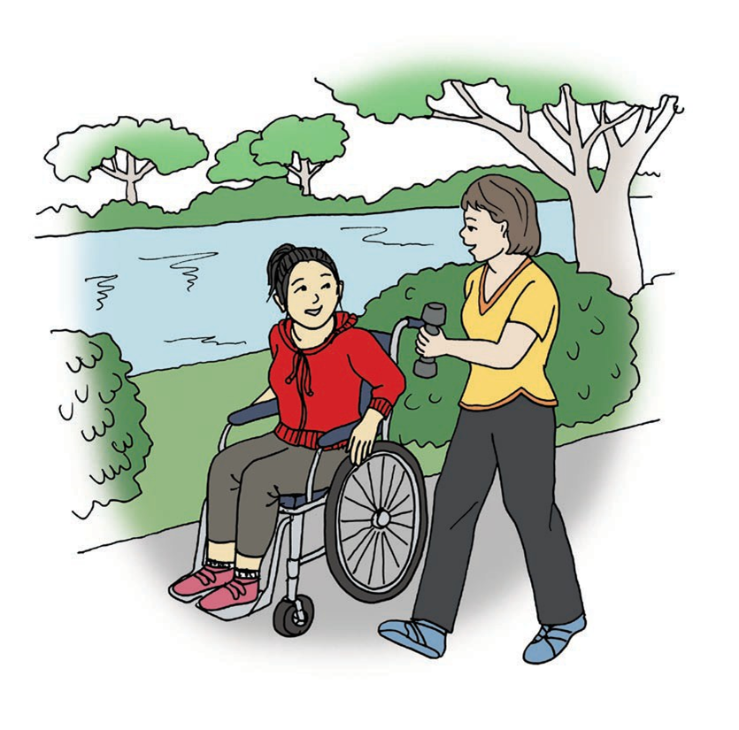
What Else Can I Do to Feel Better?
Exercising helps you feel:
Stronger and more in control
Less angry, more calm
Less stressed
Happier
Better about yourselves
Less lonely, more a part of things
Eating Healthy
Stronger and healthy
Less stressed
Happier
Better about yourselves
Taking medication
You should ask questions about any medications, including what they are for and what they will do.

Slide 9
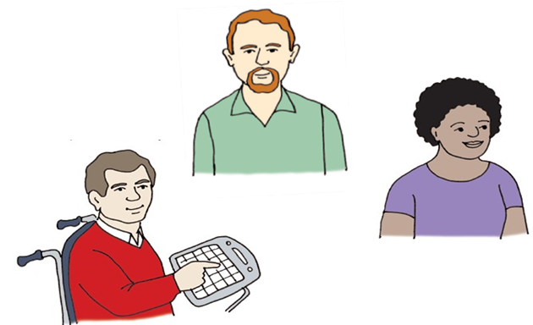
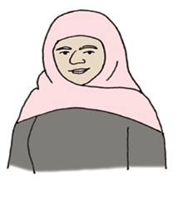
Reasons I May Need Help with My Mental Health
What are some reasons you may need to ask for help?
Too much stress caused by finances, relationships, health, or transportation issues
Difficult life experiences
Not knowing how to cope with feelings
Family history of mental health problems
When a loved one dies or leaves
Medical reasons
Feeling lonely
History of trauma

Slide 10


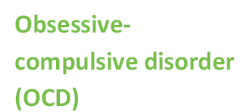
Some Examples of Mental Health Diagnosis
Post-traumatic stress disorder (PTSD)
Depression
Want to learn more about a mental health diagnosis?
Ask your doctor or mental health expert for a website on the diagnosis.
Ask your doctor or mental health expert for more information.

Slide 11
What To Do in a Mental Health Emergency?
One example of a mental health emergency is when my feelings are so strong that I am physically hurting myself or another person.
This type of emergency is called a mental health crisis.
What do I do in a mental health crisis?
  Call the 24/7 crisis helpline at 1-800-273-8255.
  Call 9-1-1 for emergencies!
When you call someone will offer advice, such as telling you to go to the hospital. Or an ambulance may come and take you to the hospital.

Slide 12

What Can be Done to End Mental Health Stigma?
The best way to end the stigma is to…
Talk about mental health
Recognize that it is normal to have difficulty with your mental health
Know that it is always OK to seek mental health help whenever you need it
End the Stigma

Slide 13
What Did I Learn?
I can take charge of my mental health when I:
Know what mental health is.
Am aware of changes in my feelings and emotions.
Reach out for support to get better.
Try new things to help me get well again.
Know that everyone can have problems and concerns with their mental health at any time.
Know what to do in an emergency.
Know how I can help end mental health stigma.

Slide 14



Created in partnership with:
  Oregon Self Advocacy Coalition,
  Oregon Health and Science University, and
  Oregon Council on Developmental Disabilities
This PowerPoint is adapted from materials developed by NSW Council for Intellectual Disabilities (2009), Australia.
The toolkit and its components are supported in part by Grant/Cooperative Agreement #5 U27 DD000014 from the Centers for Disease Control and Prevention, Disability and Health Branch. The contents of the toolkit are solely the responsibility of the authors and do not necessarily represent the official reviews of the CDC.

